Slide 1
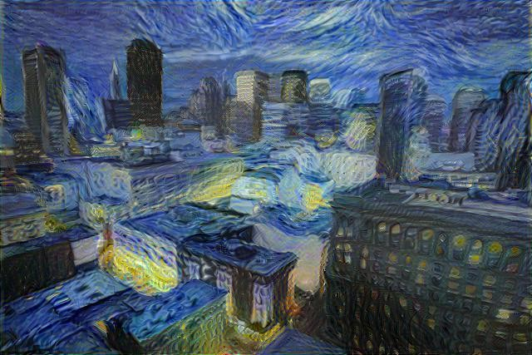
Art Creation Using Neural Style Transfer
Amit Yadav (00220703119)
Pushkar Raja (01020703119)
Sumit Jha (02820703119)
Shivam Maurya (03520703119)

Slide 2

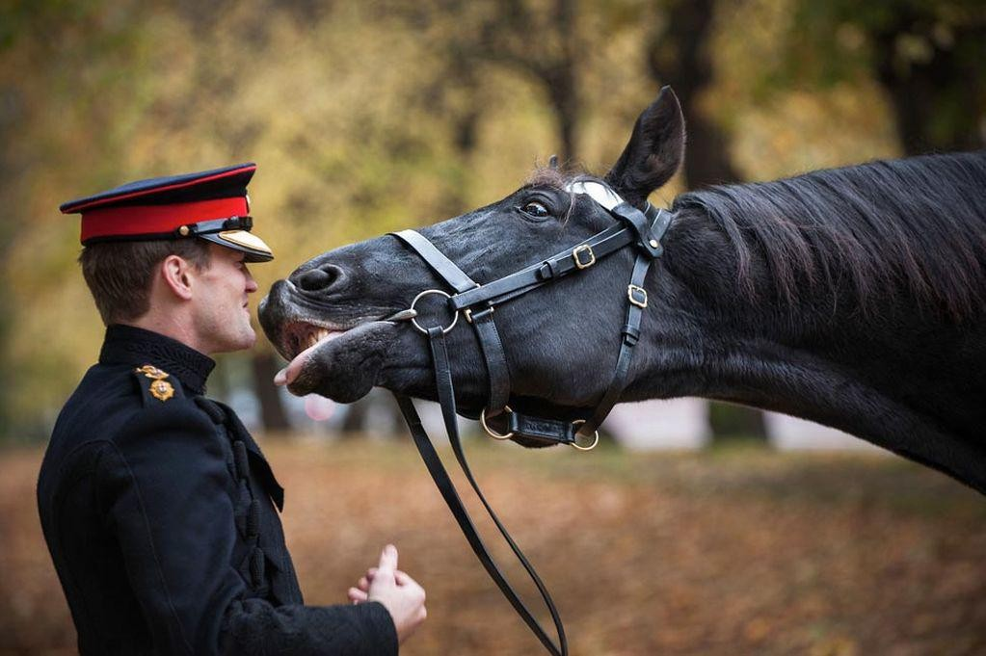
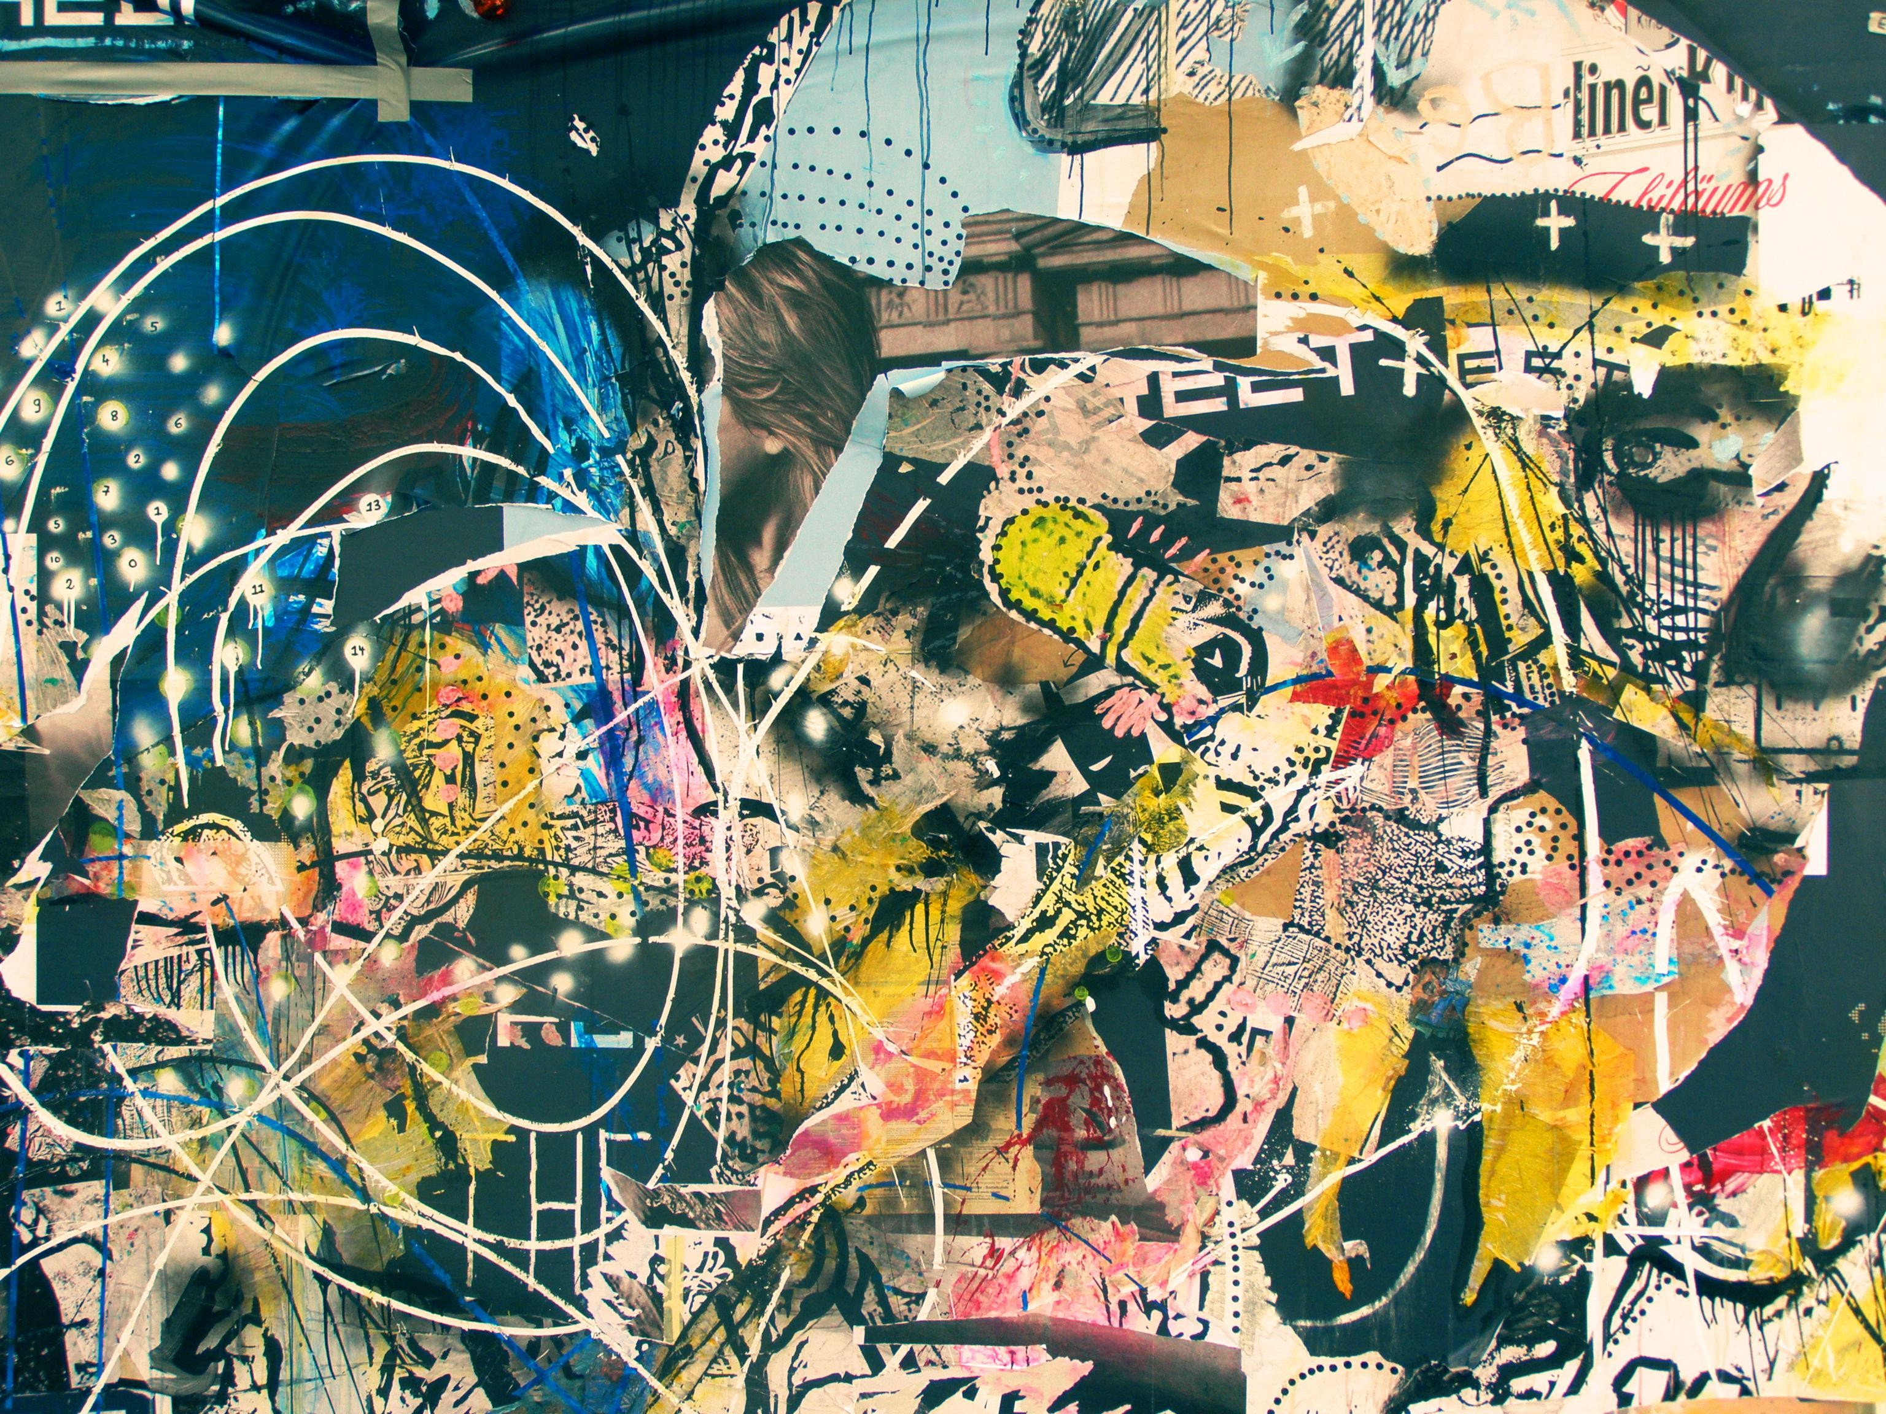
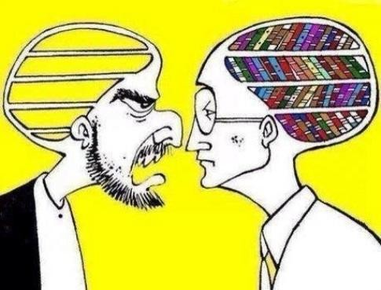
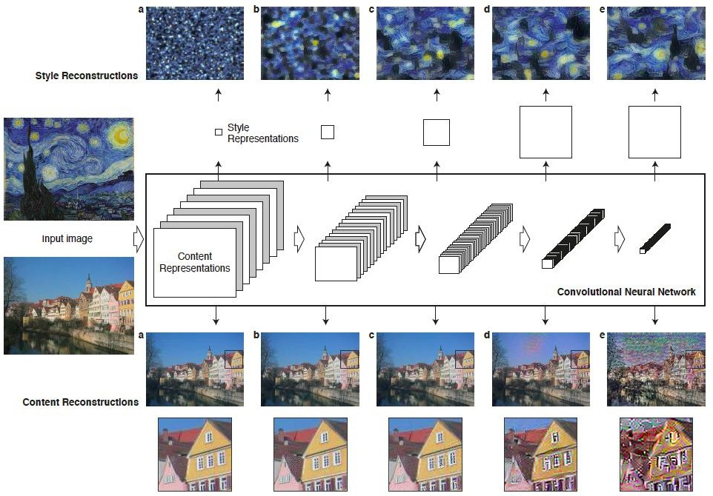

Overview of Method
Content: Global structure. Style: Colours; local structures
Like naturalistic, photographic, abstract, symbolistic
Use CNNs to capture style from one image and content from another image.
Feature representations Filter correlations
Content Style

Slide 3
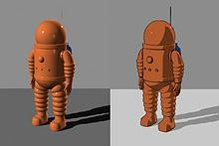
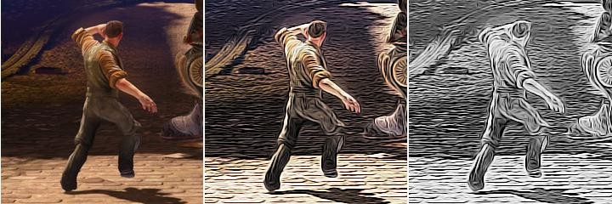
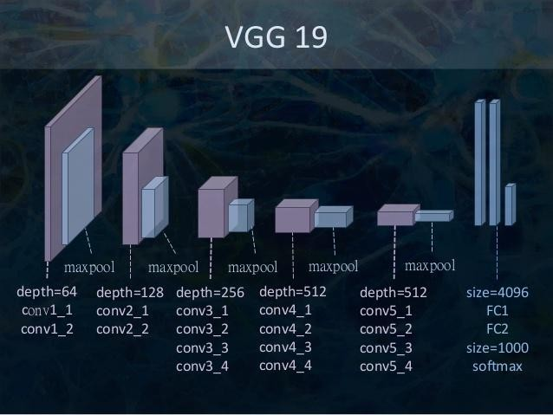
Motivation for method
Non photorealistic rendering(NPR) style/texture transfer methods
Deep Neural Networks (VGG)
manipulations in feature spaces

Slide 4
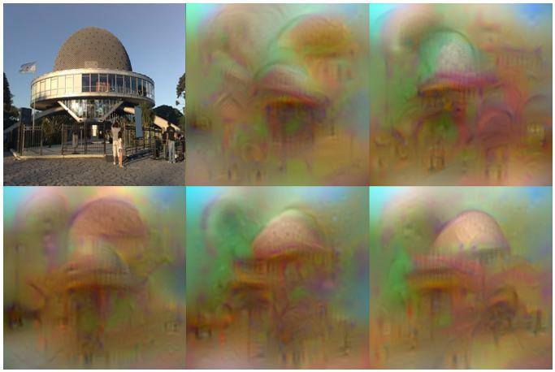
Reconstructing an image from a convolutional layer
_{Φ : ℜ}H ×W ×C _{→ ℜ}d
Representation function: (image space to feature space)
Target Representation:
Φ₀ = Φ(x₀ )
(x0 is the original image)
_{x ∈ℜ}H ×W ×C
We need to find: by minimizing:
x* = arg min
_{x∈ℜ}H×W×C
l(Φ(x), Φ₀ ) +λR(x)
“Understanding Deep Image Representations by Inverting Them”, by Aravindh Mahendran and Andrea Vedaldi.

Slide 5
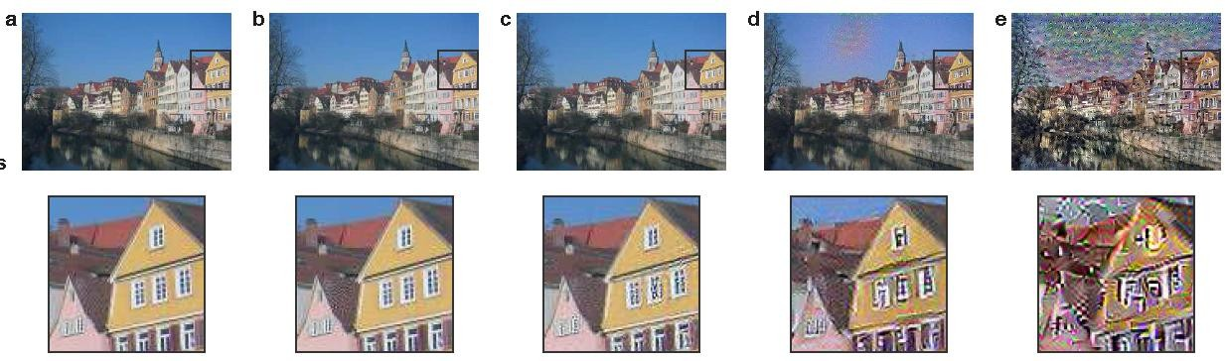
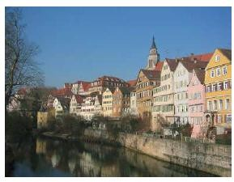
Content Reconstruction
Image reconstructed from layers (a)'conv1_1',
'conv2_1',
'conv3_1', (d)'conv4_1' and (e)'conv5_1'
of the original VGG-Network

Slide 6
Content Loss Function
Filters (Depths) at layer l: N_{l}
The height times the width of the feature map at layer l:
M_{l}
Response at layer l:
F ∈ℜ
N ×M
l
l
l
F^{l}ij
represents the ith filter at position j in layer l
Original image:
p
We generate image:
x
(randomly initialized)
Squared-error loss:
L = ¹ ∑(F^{l}ij − P^{l}ij )²
content
2
i, j

Slide 7
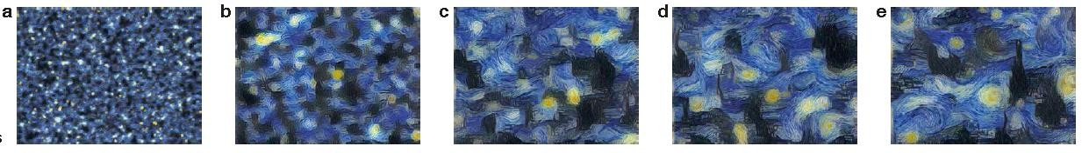
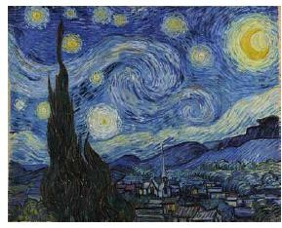
Style Reconstruction
Style representations (filer correlations) from:
(a) 'conv1_1',
(b) 'conv1_1', 'conv2_1',
(c) 'conv1_1', 'conv2_1', 'conv3_1',
(d) 'conv1_1', 'conv2_1', 'conv3_1', 'conv4_1',
(e) 'conv1_1', 'conv2_1', 'conv3_1', 'conv4_1', 'conv5_1'.

Slide 8
Style Loss Function
Filter correlations are given by the Gram matrix:
_{G}l _{∈ℜ}N_{l} ×N_{l}
G^{l}_{ij} is the inner product between the filters i and j in layer l:
G^{l}ij = ∑ F^{l}ik F^{l} jk
k
The loss at layer l:
1 4N ²l M ²l
E =
∑
i, j
l
A <-> original image
G <-> generated image
(G − A^{l}ij )²
l
ij
The total style loss:
L
^{L}style ⁼ ∑ ^{w}l ^{E}l
l =0

Slide 9
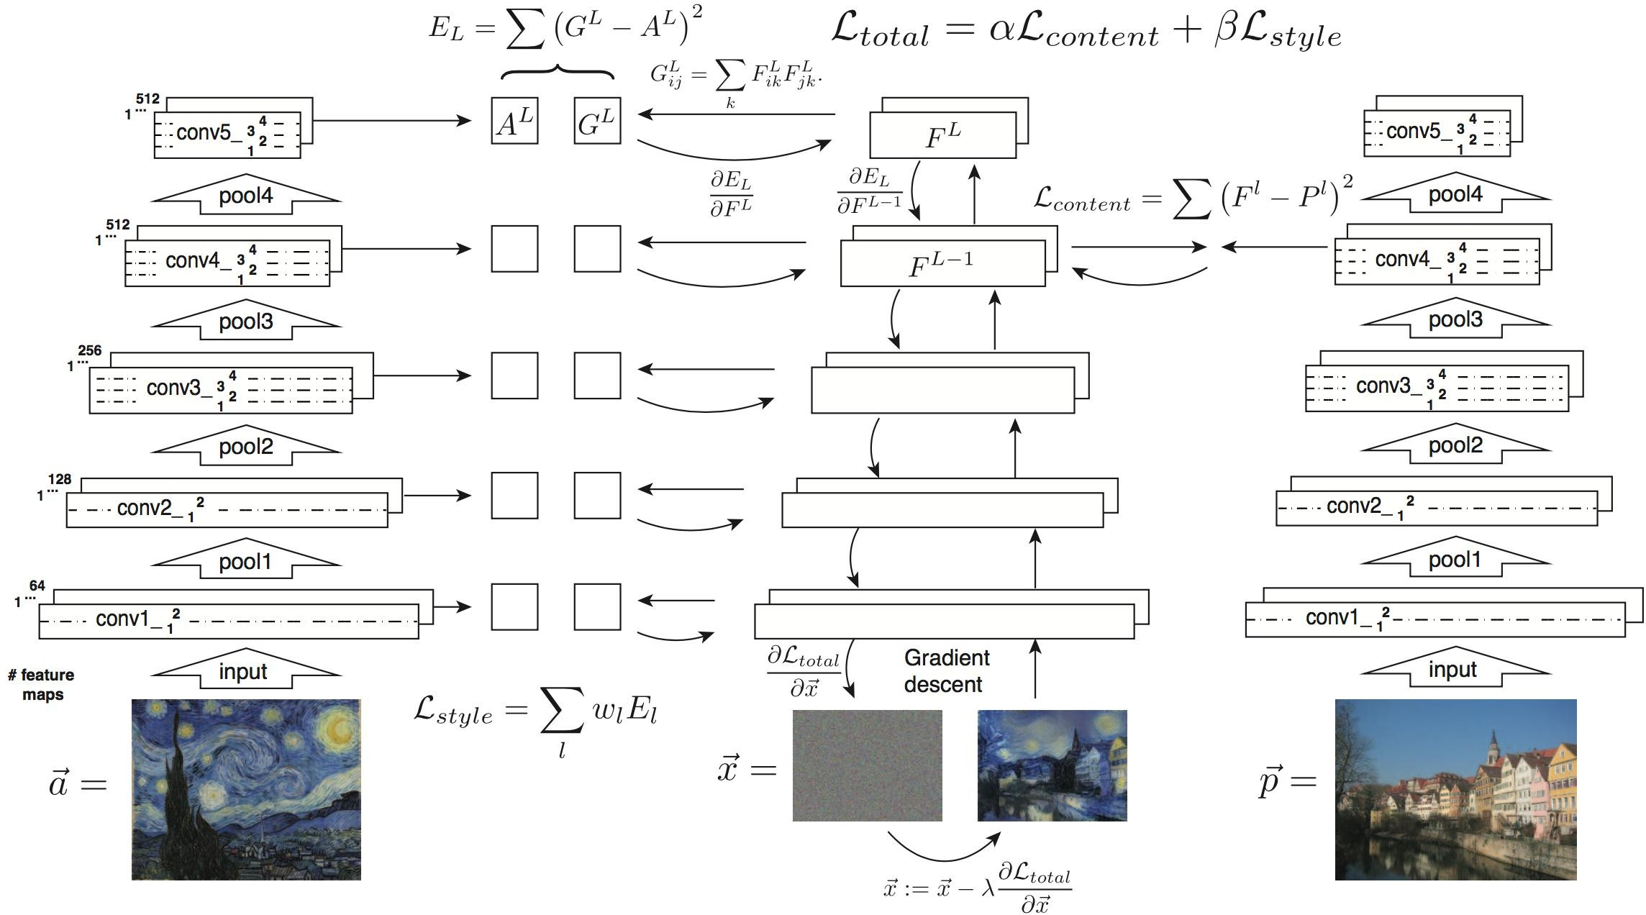
The Total Loss Function

Slide 10
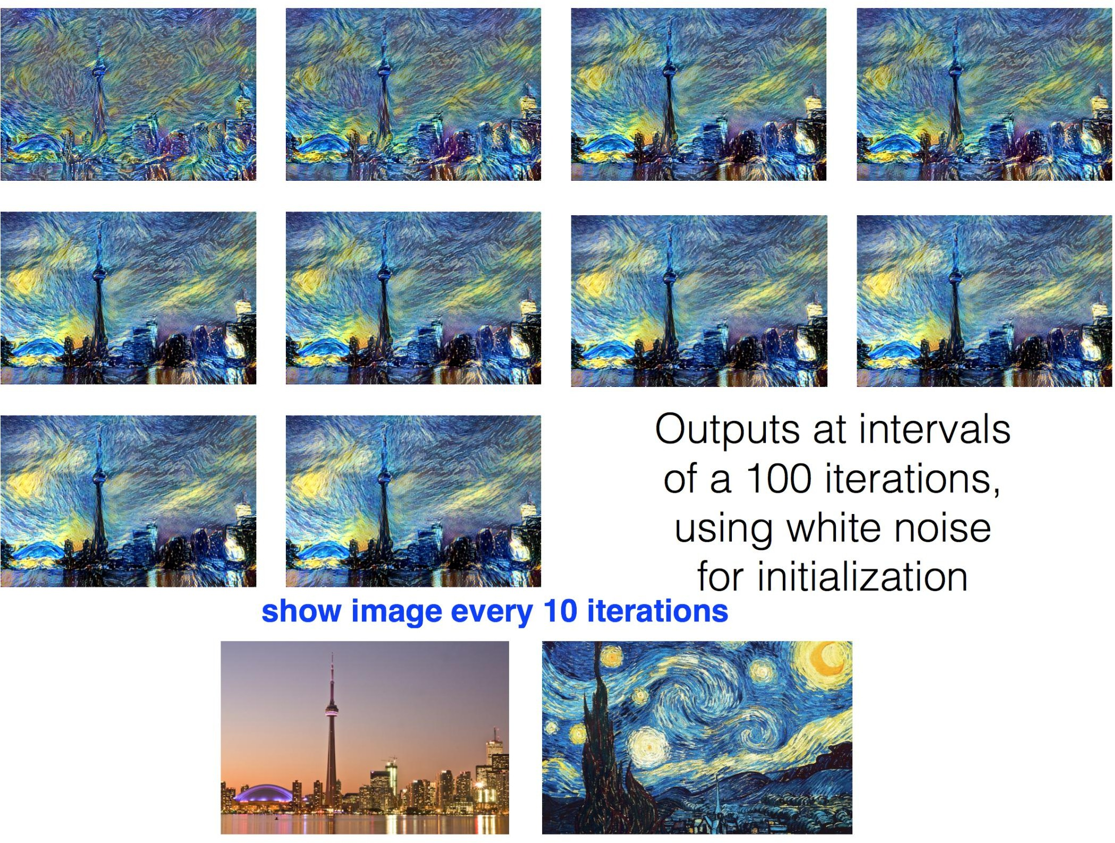

Slide 11
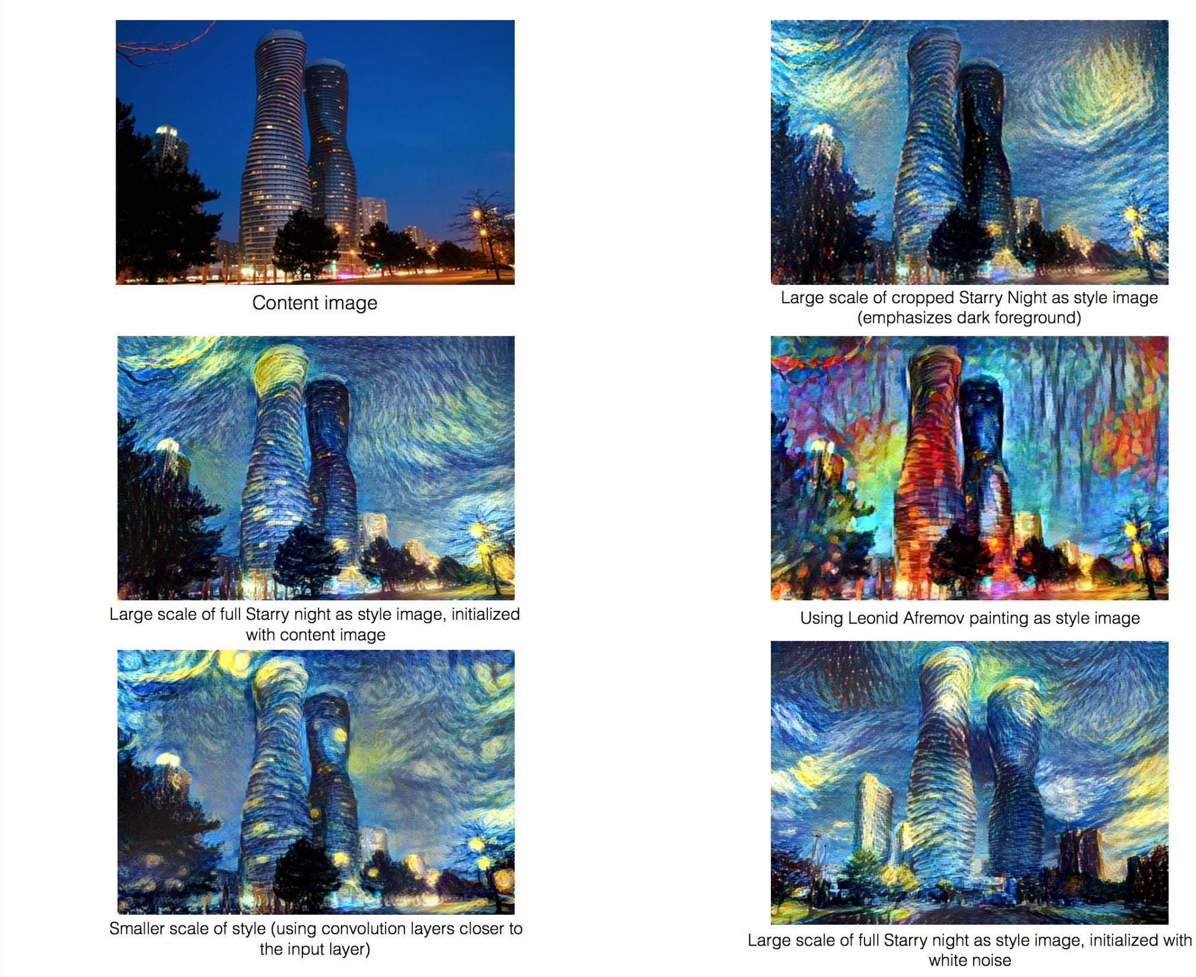

Slide 12
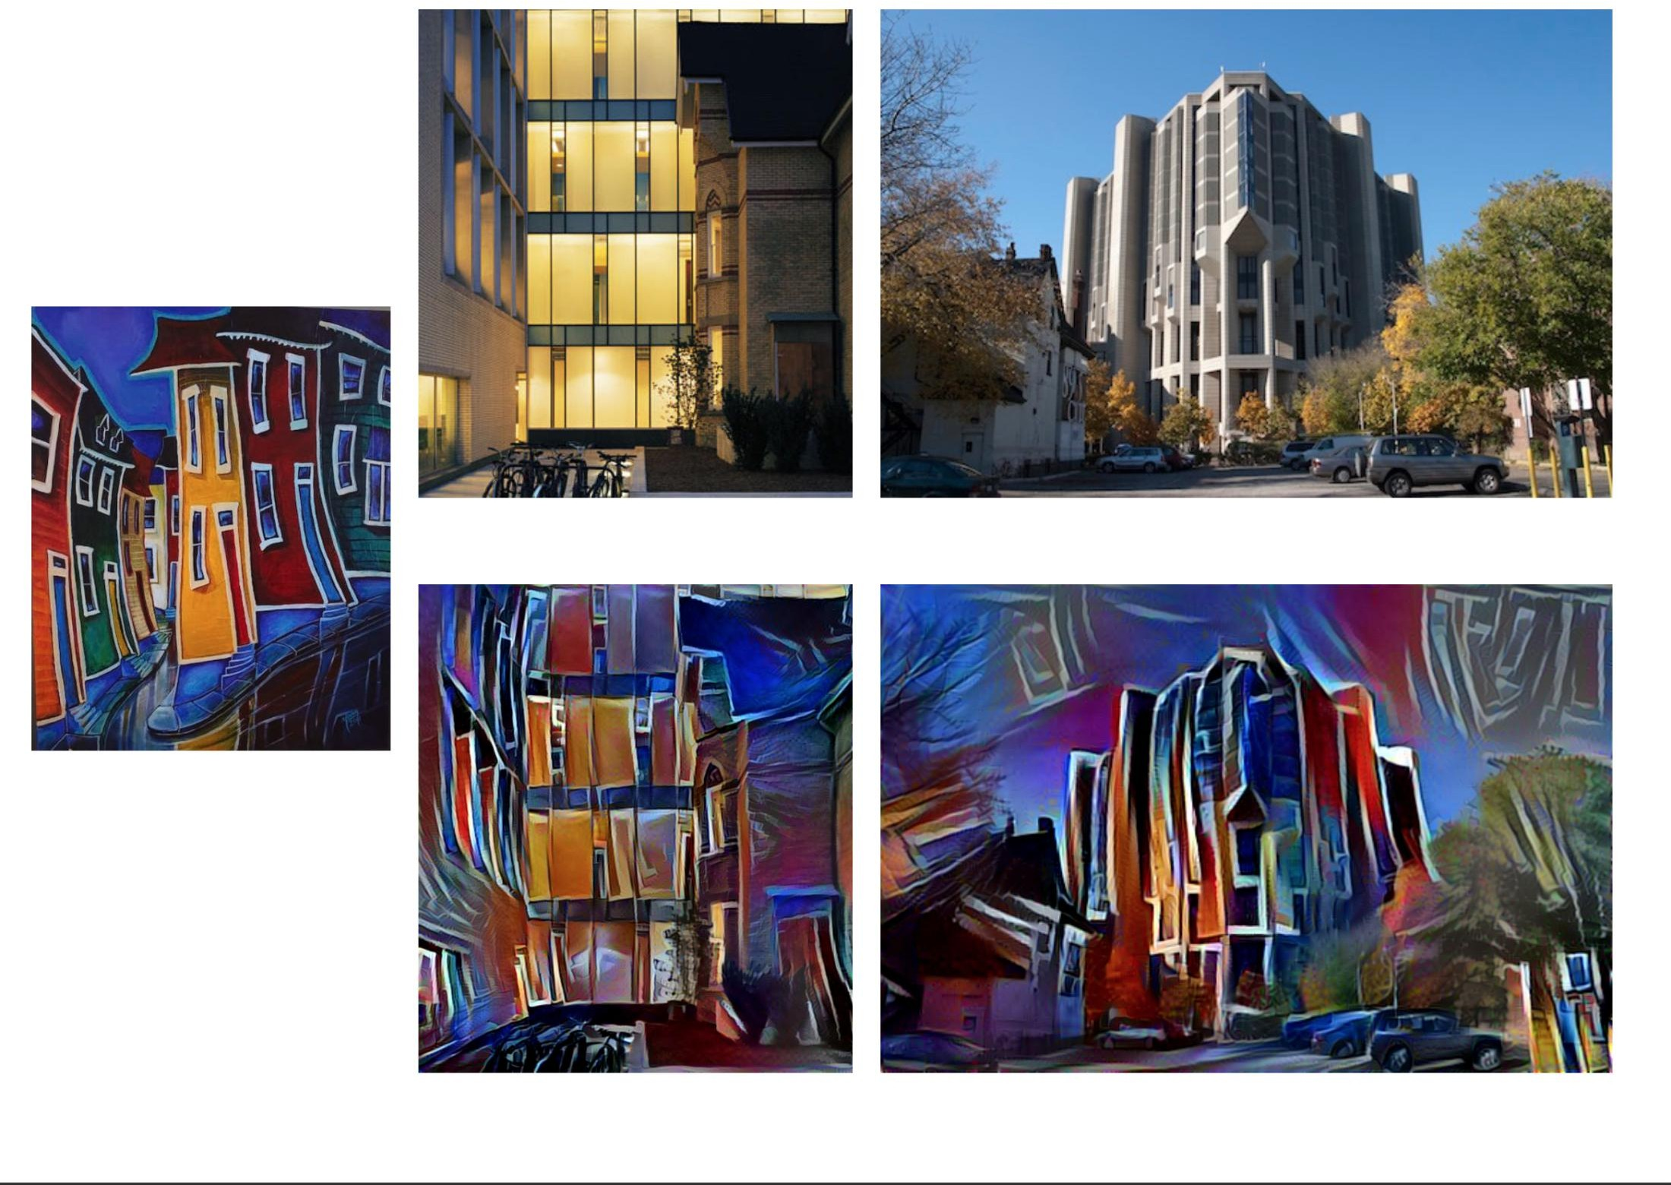

Slide 13
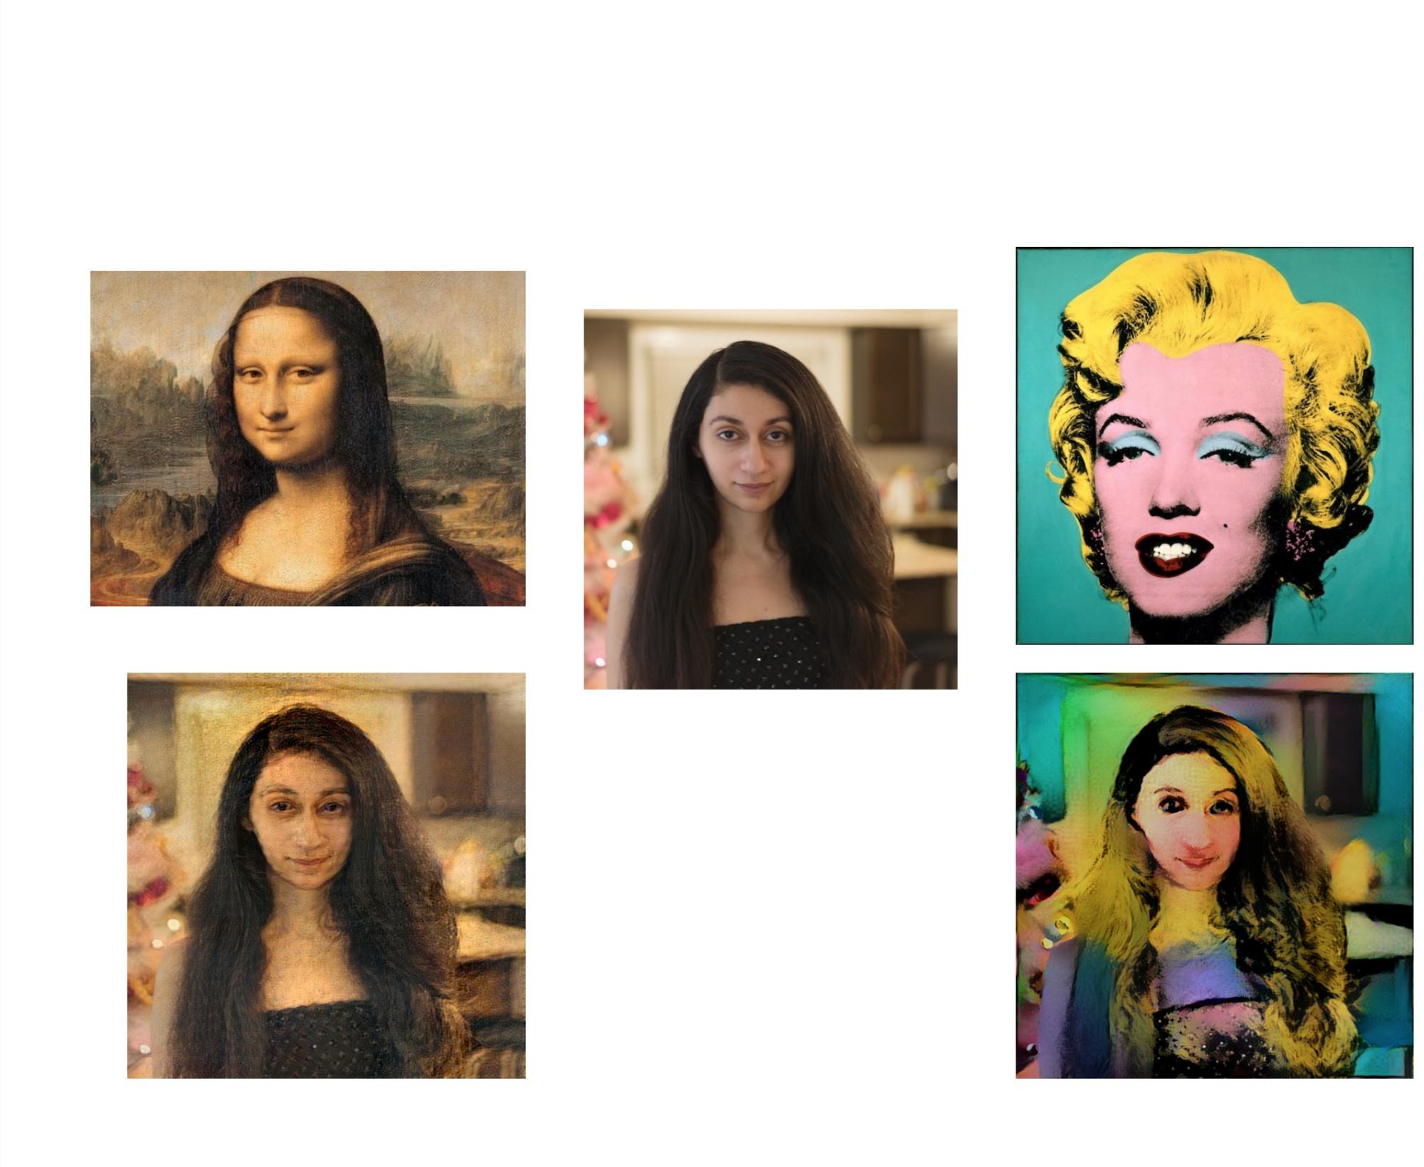

Slide 14
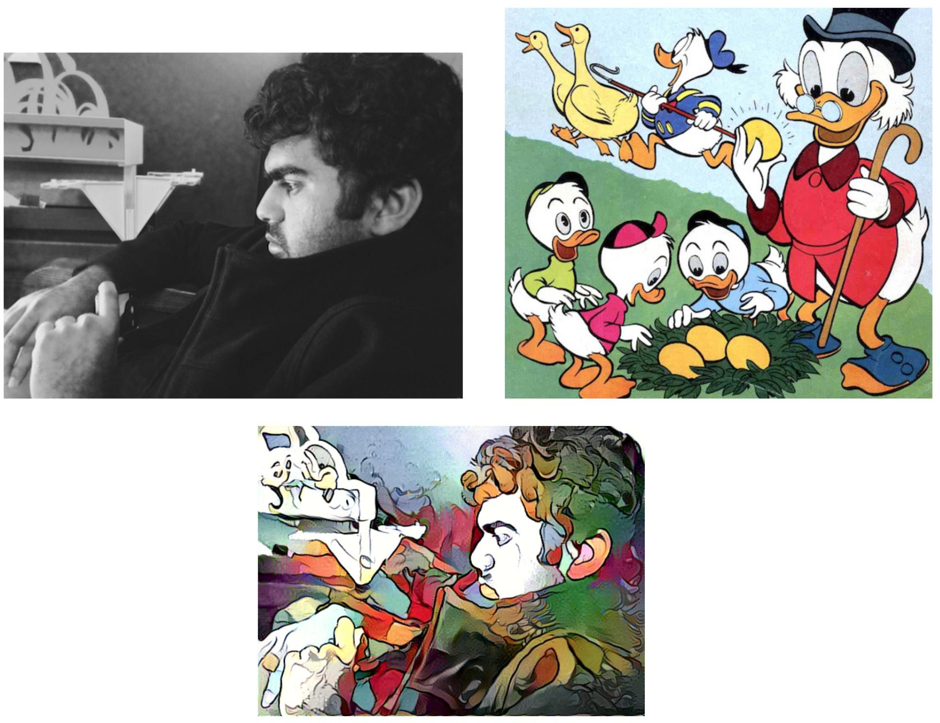

Slide 15
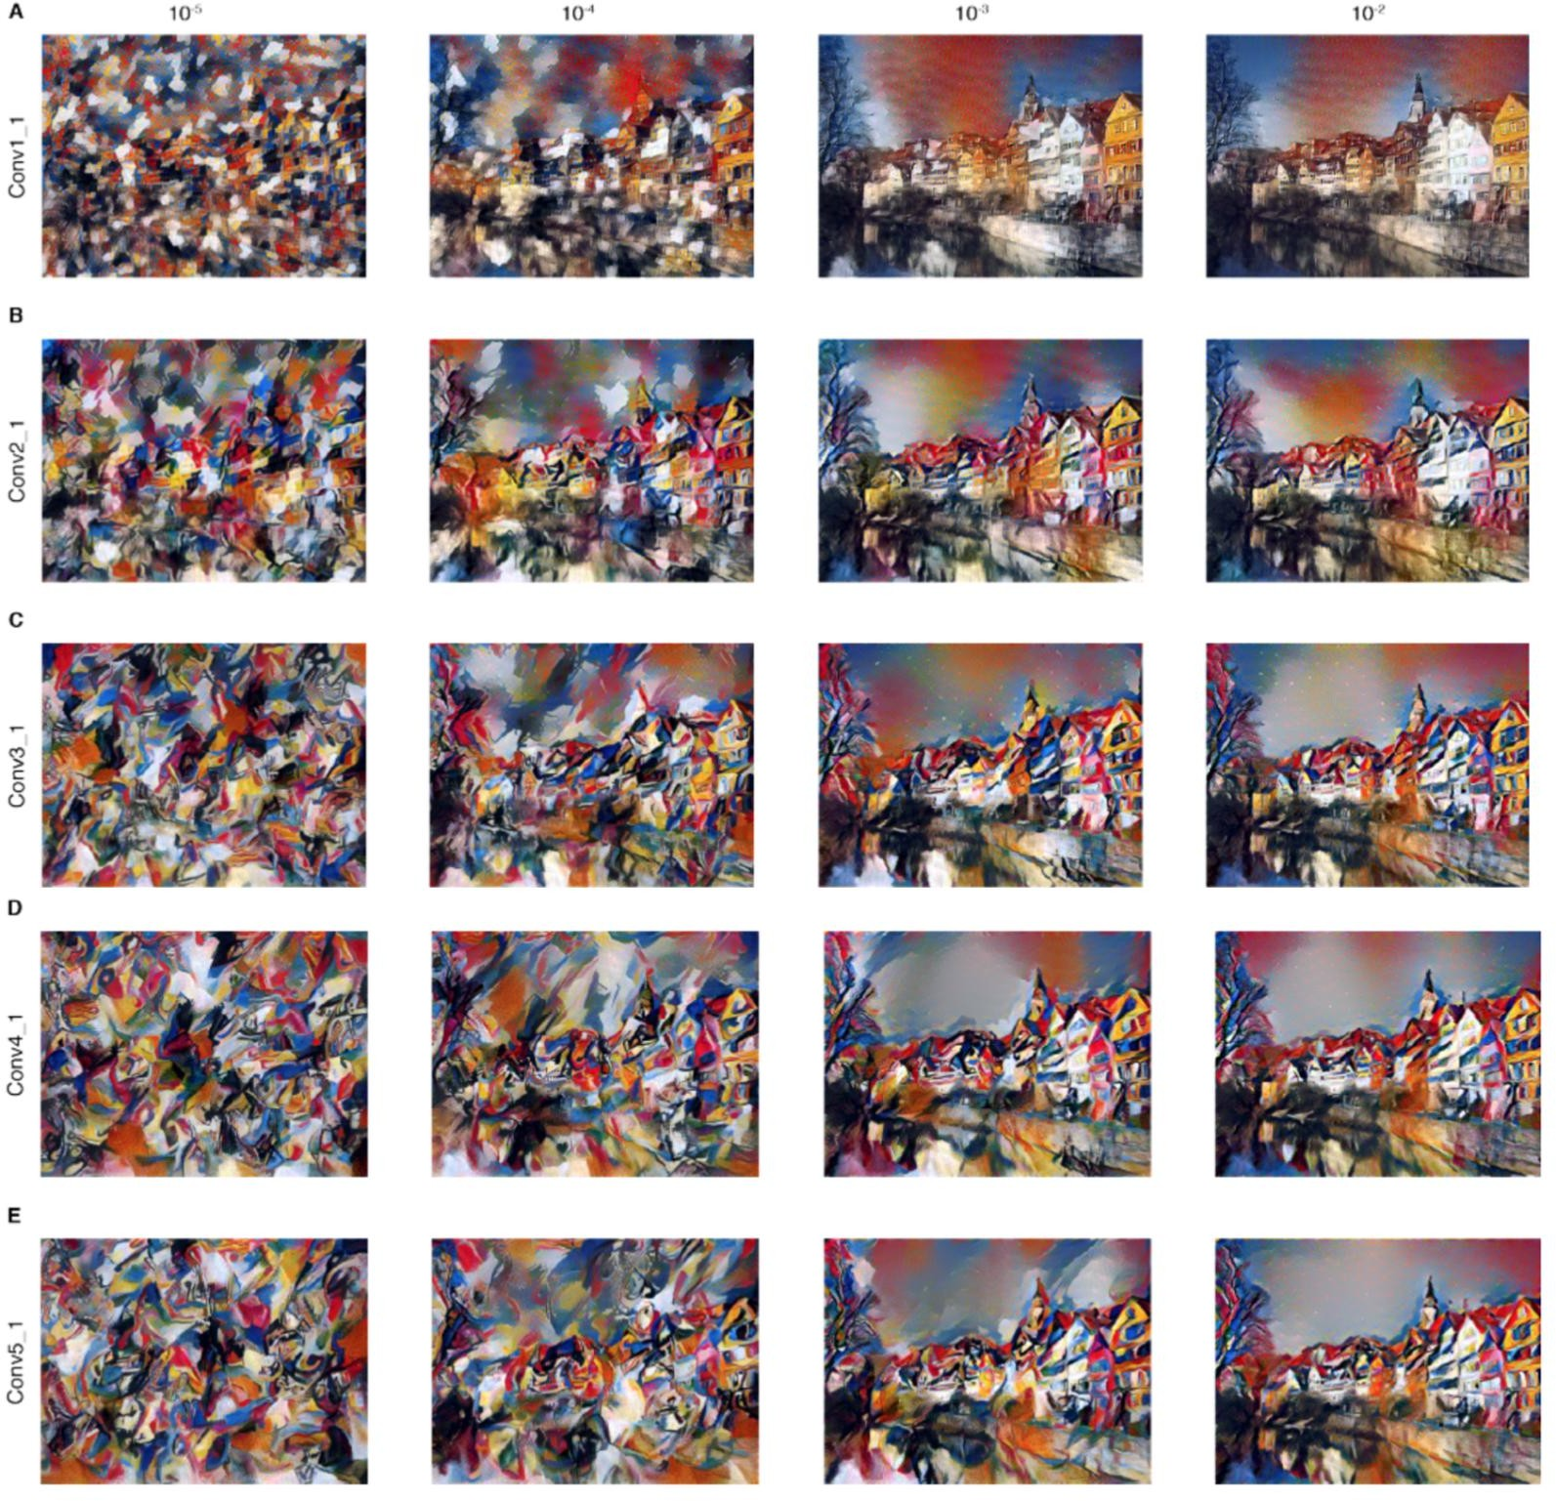

Slide 16

Conclusion
The method appears to work very well and is easy to implement.
New method of mixing content and style from different sources.
Useful for studying the neural representation of art, style and content-independent image appearance.

Slide 17
THANKYOU

